Slide 1
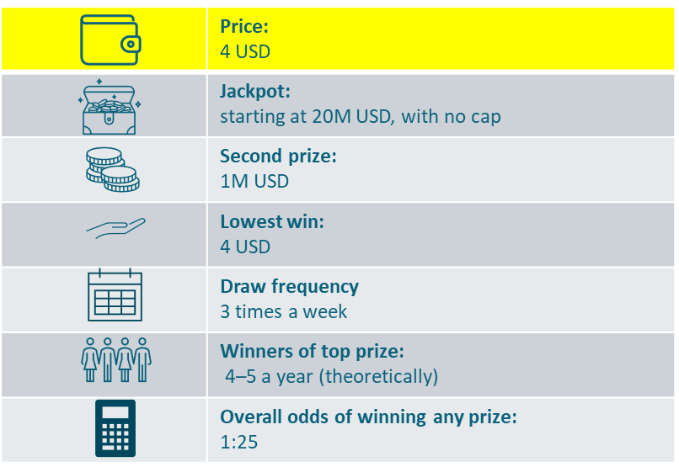
Powerball Imagine a new lottery game is being launched:
This lottery game will be offered internationally. Thanks to the shared pool between many participating countries, this will be the world´s biggest lottery. Its jackpot could reach over half a billion USD. The average jackpot will be about a quarter of a billion USD, with the minimum level of the jackpot guaranteed to be 20 million USD.
To enter, you select 5 numbers out of 69 and 1 number out of 26 for each line played, or simply use the random number generator option.
Price per participation is 4 USD. For this price, you get 2 lines, in other words, two chances to match the 5+1 numbers.
There are three draws per week, every Monday, Wednesday and Saturday. The top prize will be won (theoretically) 4–5 times a year.
This game would be offered in all points of sale where you can buy lottery tickets or scratch cards or online on respective websites and apps.
Notes:
Concept 1 - Powerball

Slide 2
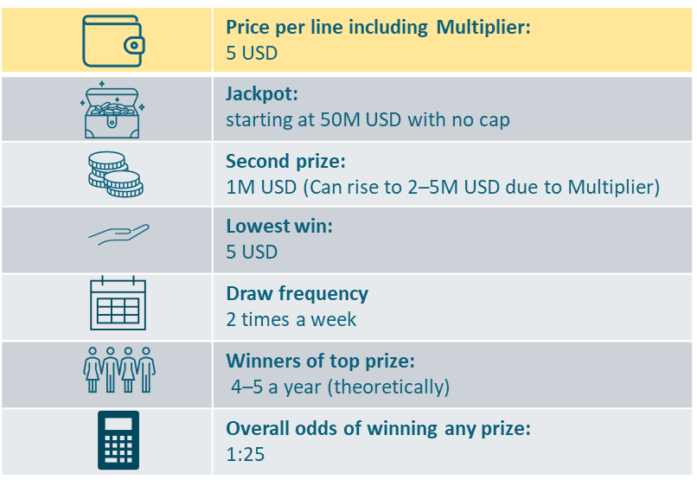
MegaMillions Imagine a new lottery game is being launched:
This lottery game would be offered internationally. Its jackpot could reach as high as 1 billion USD, with the average jackpot about a quarter of a billion USD. The minimum jackpot level is guaranteed at 50 million USD. The jackpot is paid in annual installments for 30 years. The annuity would increase over time to protect players from inflation. The payouts can be inherited as well.
To enter, you select 5 numbers out of 70 and 1 number out of 25 for each line played, or simply use the random number generator option.
Together with the main game, there is also an add-on game that multiplies all winnings (except for the jackpot) by 2, 3, 4 or 5. The Multiplier number is drawn before each draw. Therefore, players who win 1 million in the second prize tier can multiply their winnings to 2, 3, 4 or 5 million USD.
The price per participation is 5 USD. For this price, you get 1 line of the main game and also the add-on multiplier.
There would be two draws per week. The top prize is won (theoretically) 4–5 times a year.
This game would be offered in all points of sale where you can buy lottery tickets or scratch cards or online on respective websites and apps.
Notes:
Concept 2 - MegaMillions

Slide 3
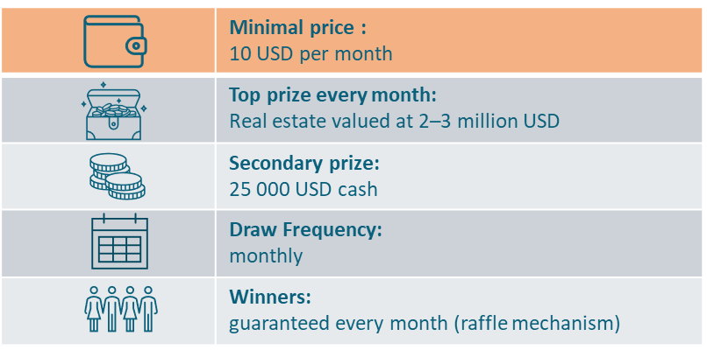
Omaze-inspired Imagine a new lottery game is being launched:
This lottery would be a monthly raffle played internationally. Thanks to the shared pool, it would offer exclusive dream houses every month. It could be a villa in Malibu in the January draw, then a luxurious condo in Colorado in February, a penthouse apartment in New York, or a bungalow on a Caribbean island.
There will be also hundreds of cash prizes of 25 000 USD.
There is no need to choose any numbers to enter the game. Your purchase generates a unique code which will be put into a database. This means that the more entries you buy, the more times your code will appear in the database. The winner will then be drawn at the end of the month using a randomized draw engine.
The only purchase option is online subscription.
You can choose how many times you want your code to be put into the database. For 10 USD a month, you get 30 entries in the monthly raffle. For 30 USD a month, you get 100.
For those players who participate in all 12 draws of the year, there will be a free Grand Draw on New Year‘s Day for a multi-million dollar prize on top of the monthly prizes.
The subscription can be canceled at anytime during the year.
Notes:
Concept 3 – Omaze-inspired

Slide 4
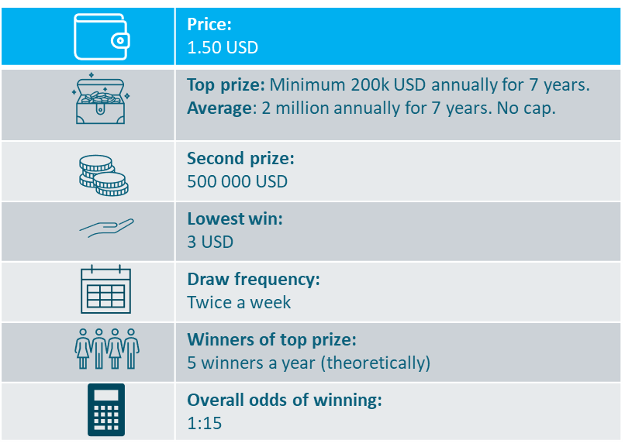
Progressive annuity Imagine a new lottery game is being launched:
This lottery game would be offered internationally. Thanks to the shared pool among participating countries, the game can offer a substantial top prize in the form of an annual payment, starting at a minimum of 200 000 USD per year for 7 years, and potentially reaching as high as 5 million USD annually for 7 years.
If the top prize is not won in the initial round, it is rolled over. The top prize then increases from 200 000 USD to 270 000 USD annually for 7 years and continues to grow after each draw until won.
To enter, you select 7 numbers out of 45 or opt to for random number generation.
Price per 1 entry is 1.50 USD.
Draws will take place twice a week. The top prize will be won (theoretically) once every 10 weeks.
This game would be offered in all points of sale where you can buy lottery tickets or scratch cards or online on respective websites and apps.
Notes:
Concept 4 – Progressive annuity

Slide 5
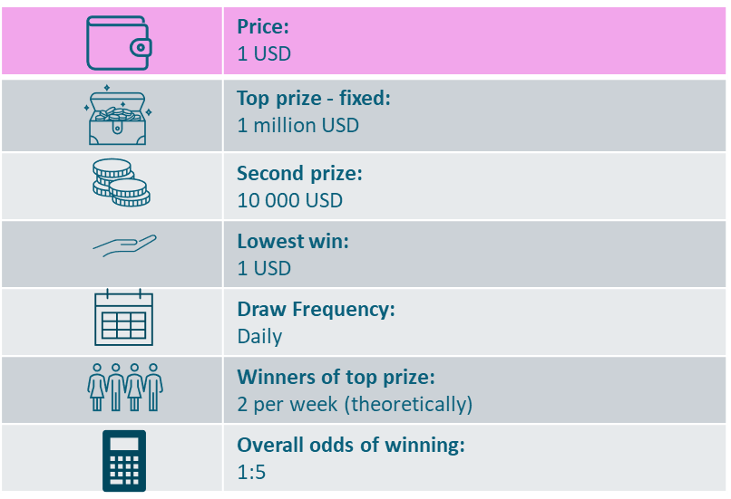
Daily Millionaire Imagine a new lottery game is being launched:
This lottery would be offered internationally and allow players to win a fixed top prize of 1 million USD on a daily basis.
To enter, simply select 6 numbers out of 40 or use the random number generator option.
Price per 1 entry is 1 USD.
The top prize would be won (theoretically) once every 3 draws. The overall odds of winning any prize are fairly high in this game: one in five lines.
Draws take place every evening in Finland.
This game would be offered in all points of sale where you can buy lottery tickets or scratch cards or online on respective websites and apps.
Notes:
Concept 5 – Daily Millionaire

Slide 6
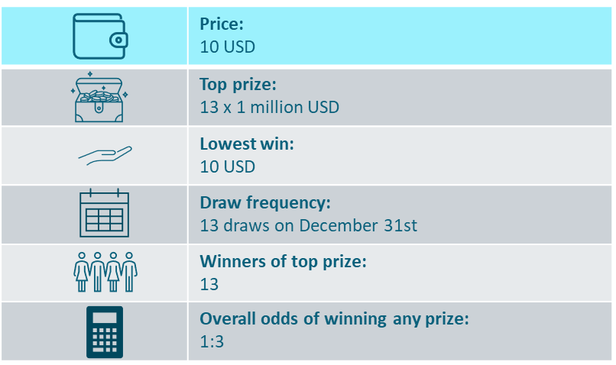
New Years Eve 13 millionaires Imagine a new lottery game is being launched:
This lottery is a once-a-year game, played only on New Year's Eve in Illinois, with 13 draws throughout the day, every hour on the hour, starting at noon and ending at midnight.
Thanks to the shared pool among participating countries, the game can offer thousands of prizes in each draw. The 13th draw, which will take place at midnight, will be a special draw determining 13 winners of a final cash prize of 1 million USD each.
One ticket costs 10 USD, and this ticket grants entry to all 13 draws. Each ticket can be divided into 5 parts and shared with family and friends.
To enter, you do not need to choose any numbers; the ticket contains a unique code (a combination of numbers and letters) that serves as entry for each draw.
Sales open on December 1st. This game would be offered in all points of sale where you can buy lottery tickets or scratch cards or online on respective websites and apps.
Notes:
Concept 6 – New Years Eve 13 millionaires

Slide 7
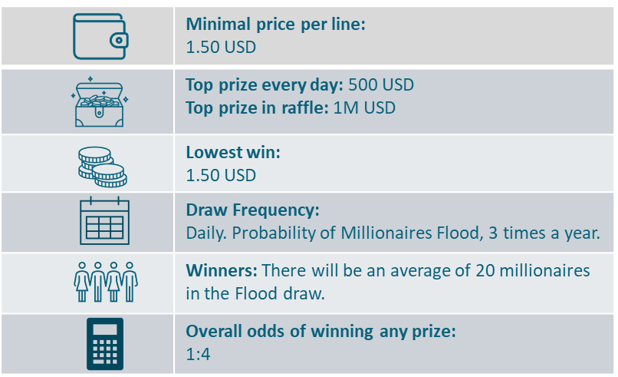
Millionaires Flood Imagine a new lottery game is being launched:
This lottery is a daily game. It will be offered internationally, and thanks to the shared pool, will include a special feature called “Millionaires Flood” on top of the regular prizes. A portion of the revenue will be collected in the Millionaires Flood Fund, which can reach over 50 million USD.
To enter the game, choose your 5 numbers out of 17 and watch the evening draw to find out not only if you match the winning numbers, but also to see if it is a "Millionaires Flood“ day. These will happen in every draw when all 5 drawn numbers are even. For example, if the fund on that day stands at 25.5 million USD, then 25 players will be selected based on their ticket code. These players will then win 1 million USD each.
The minimum entry price is 1.50 USD, which gives you the chance to win in one of the 6 winning categories in the daily game. Moreover, your lottery ticket qualifies you for the Millionaires Flood raffle if it occurs in the given draw.
This game would be offered in all points of sale where you can buy lottery tickets or scratch cards or online on respective websites and apps.
Notes:
Concept 7 – Millionaires Flood

Slide 8
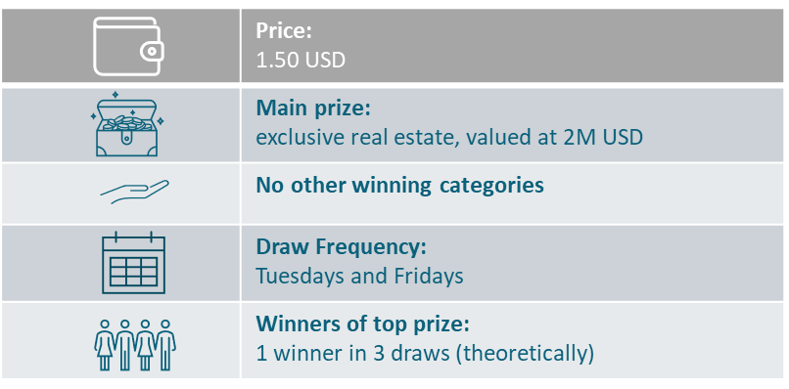
Real estate prizes added to existing lottery Imagine a new add-on game for lottery players:
This new game would be an add-on to an existing multinational lottery that offers huge jackpots. For an additional 1.50 USD per ticket, players would also participate in an additional raffle draw where they could win exclusive non-cash prizes such as villas in Denver, Colorado, or in a famous spa resort, or penthouses in European/US metropolises, an apartment at Lake Como, etc. These exclusive prizes can be offered thanks to an internationally-shared pool.
To participate in this add-on raffle, players do not need to select any numbers. The serial number of the ticket will be automatically entered into the raffle if the extra 1.50 USD is paid.
There will be no lower prize categories. Draws for the add-on raffle will coincide with the draws of the accompanying multinational (and multi-state) jackpot lottery games.
Notes:
Concept 8 – Real estate prizes added to existing lottery

Slide 9
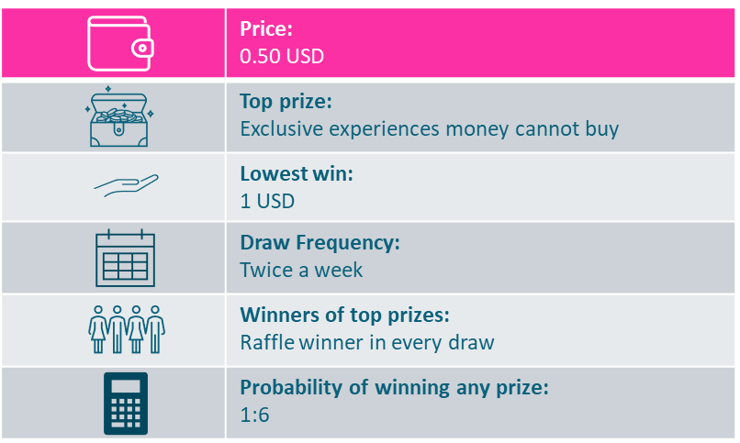
Experiential prizes added to annuity lottery (SFL)
Imagine a new add-on game for lottery players:
This new add-on game to an existing jackpot lottery would be offered internationally. Players would have the chance to win exclusive experiential prizes that money cannot buy. Examples might be:
Tickets to the Olympic Games, including meeting with athletes, trips to Formula 1 races with a VIP travel package, Gold Class tickets to concerts and festivals.
Warehouse dashes, roles as extras in hit TV shows or films, being a judge in cooking/baking TV shows or popular talent shows, a NASCAR driving simulator experience.
Training for a day with a pro football team, exclusive film premieres with dinner, luxury cruises with celebrity guides, or Broadway theatre trips.
Winners will be given a choice from a number of alternatives.
Price per 1 entry would be 0.50 USD per line played.
To participate in this add-on, players do not need to select any numbers. There will be a special code printed underneath each line of the main lottery played. These codes will be automatically entered into the raffle.
This raffle draw will take place twice a week.
Notes:
Concept 9 – Experiential prizes added to existing lottery

Slide 10
NOT RELEVANT FOR THE US MARKET
Notes:
Concept 10

Slide 11
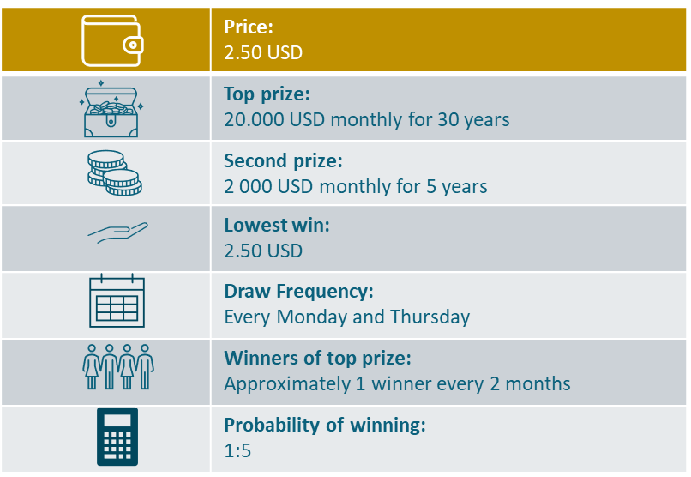
Annuity benchmark Imagine a new lottery game is being launched:
This is an international lottery numbers game in which players from participating countries play to win a dream top prize of 20 000 USD per month, paid in regular instalments over a 30-year period. The prize payout can be inherited.
To enter, pick 6 numbers from 1 to 40 and 1 bonus number from 1 to 5. If you match all 7 numbers, you win the top prize. This prize is fixed.
There is also an annuity prize in the 2nd tier: 2000 USD per month for 5 years.
One row costs 2.50 USD.
There are two draws per week: on Mondays and Thursdays.
Notes:
Concept 11 – EuroDreams (benchmark)

